Slide 1

Data Analytics - Cohort 14, Sec D
Project 2 - Maven Fuzzy Factory
by Rabbia Munir

Slide 2
Introduction:
Maven Fuzzy Factory is a toy company that sells plush bears and other fuzzy products. This dashboard provides a comprehensive overview of the company’s sales, traffic, conversion rate, and funnel performance using historical website and transaction data. The goal is to uncover insights to improve marketing strategy, website performance, and overall business growth.
Tools that I have used are MYSQL, POWER BI

Slide 3
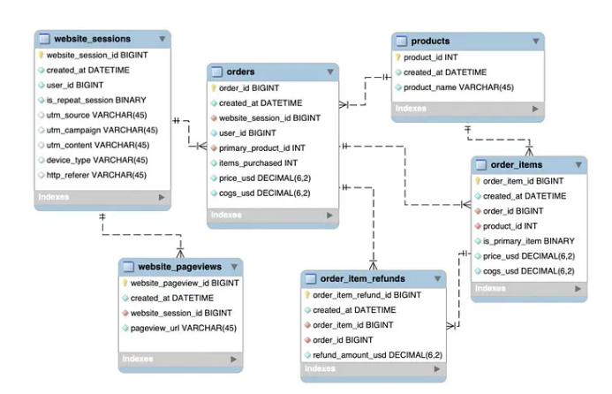
ER DIAGRAM:

Slide 4
Business Questions:
What are the sales trends over the years?
Which products generate the most revenue and refunds?
Where is the website traffic coming from?
Which UTM sources and campaigns are most effective?
How does device usage affect user behavior?
What is the monthly and quarterly conversion rate trend?
Which landing pages are performing poorly in terms of bounce rate?
How do users drop off across the conversion funnel stages?
Which products perform best in the conversion funnel?

Slide 5
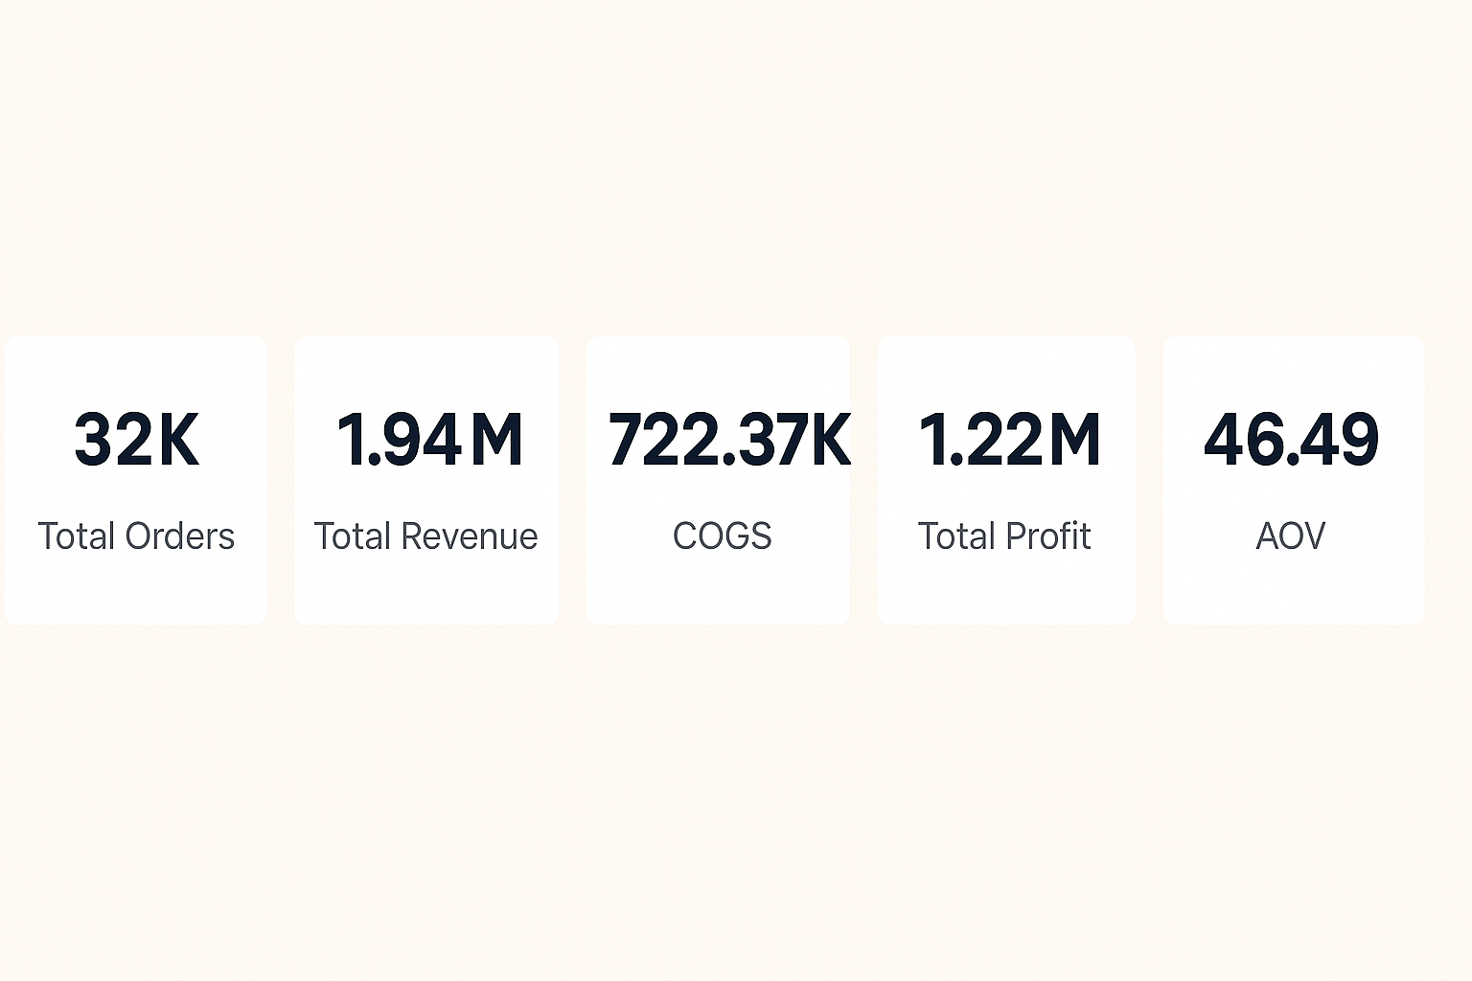
Sales Analysis
Top Metrics (KPIs)

Slide 6
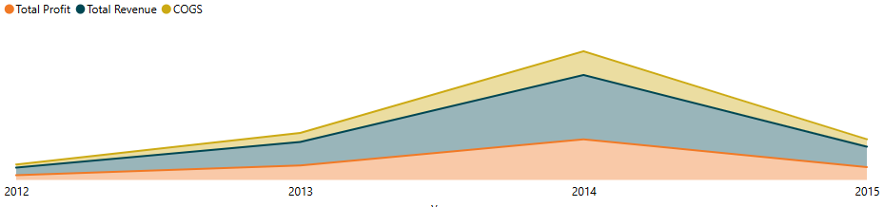
Sales Analysis
Total Profit, Revenue and COGS by Year (Stacked Area Chart)
2014 was the peak year for profit and revenue.

Slide 7
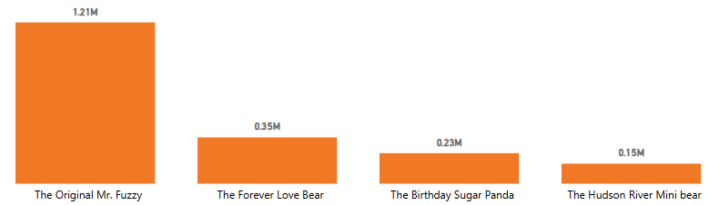
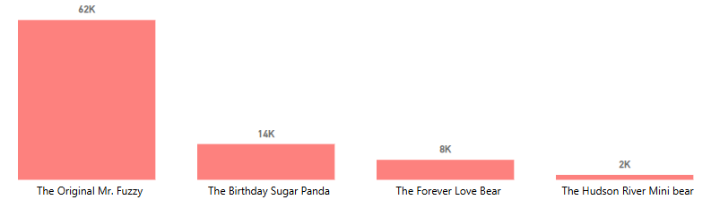
Sales Analysis
Product-wise Total Revenue (Bar Chart)
Product-wise Refunds (Bar Chart)

Slide 8
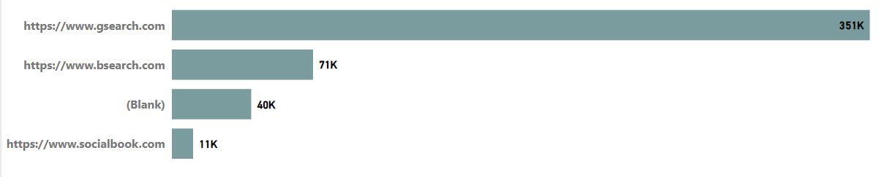
Traffic Analysis
Total Session by http Referer (stacked bar chart)
Mostly people coming from gsearch.

Slide 9
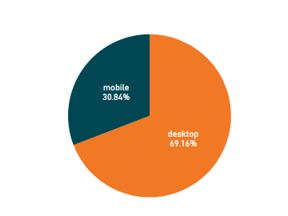
Traffic Analysis
Total sessions by device type (pie chart)
Desktop 69.16%
Mobile 30.84%

Slide 10
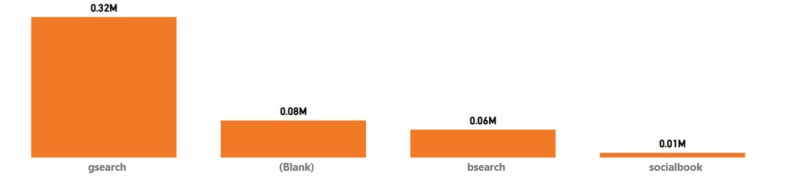
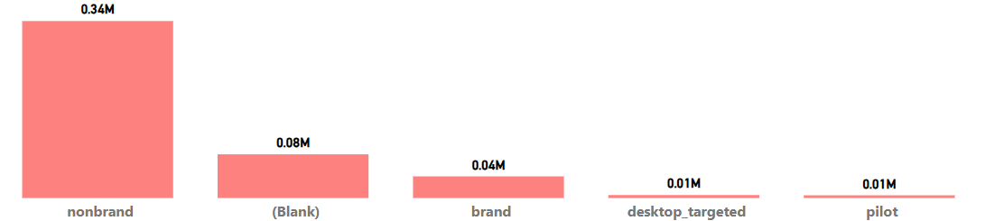
Traffic Analysis
Total session by utm source (bar chart)
Total session by utm campaign (bar chart)

Slide 11
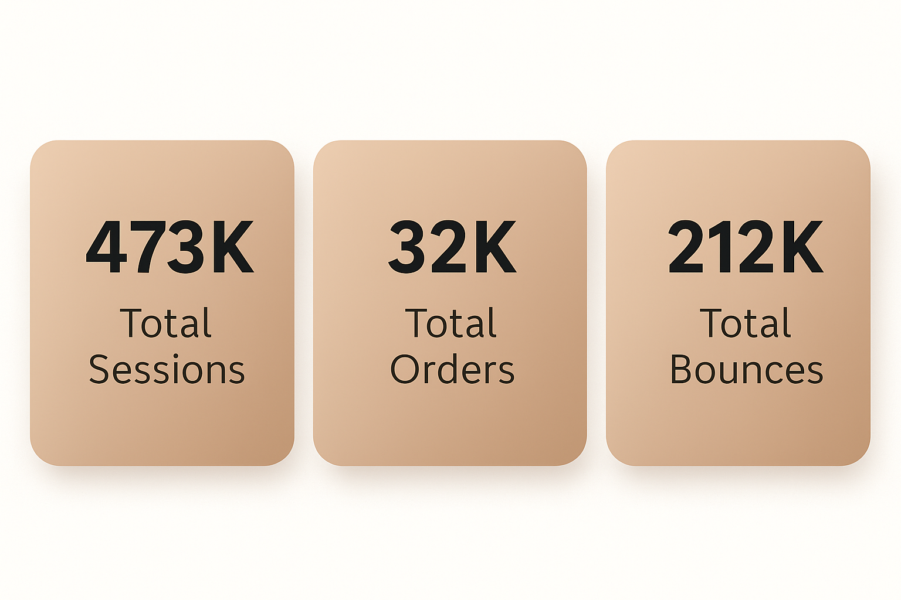
Conversion Rate (CVR Analysis)
Top Metrics

Slide 12
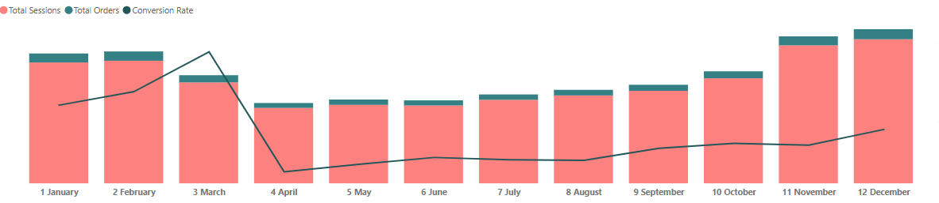
Conversion Rate (CVR Analysis)
Session to Order Conversion Rate (Line and Stack Column Chart)

Slide 13
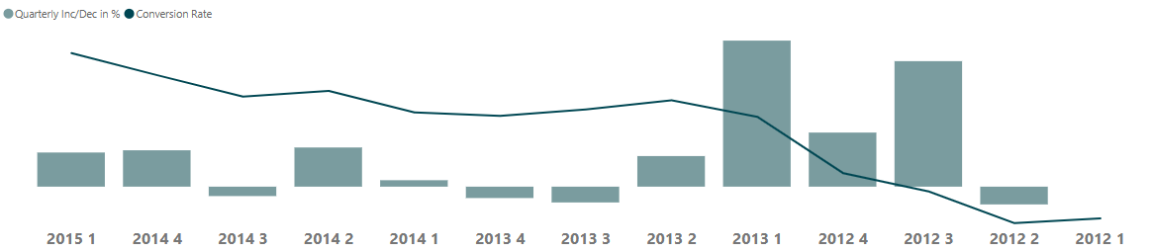
Conversion Rate (CVR Analysis)
Quarter-wise Increase/Decrease in CVR (Line and Stack Column Chart)

Slide 14
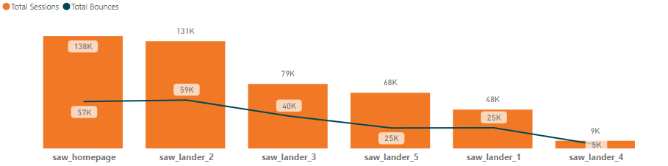
Conversion Rate (CVR Analysis)
Landing Pages Performance (Bar Chart)

Slide 15
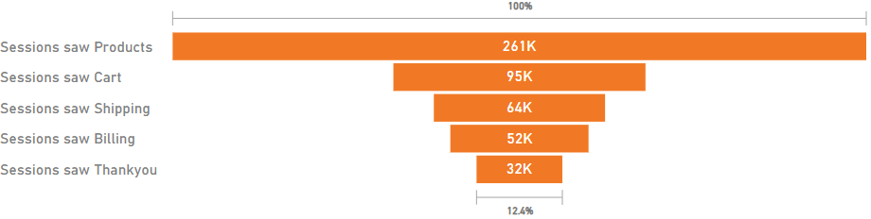
Conversion Funnels
Overall Conversion Funnel

Slide 16
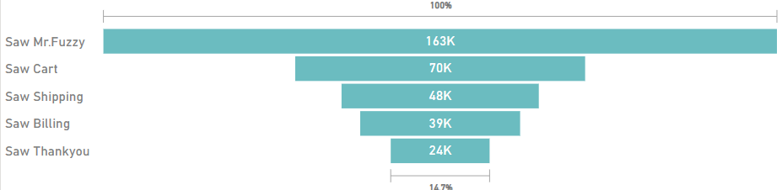
Conversion Funnels:
Product-wise Conversion Funnels
Mr. Fuzzy: 14.7% conversion

Slide 17
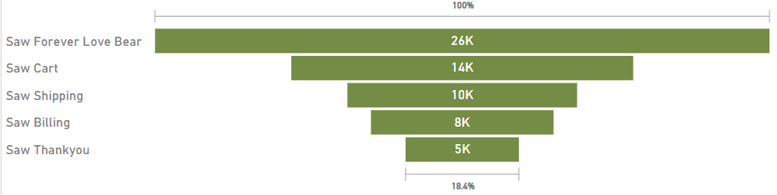
Conversion Funnels:
Forever Love Bear: 18.4%

Slide 18
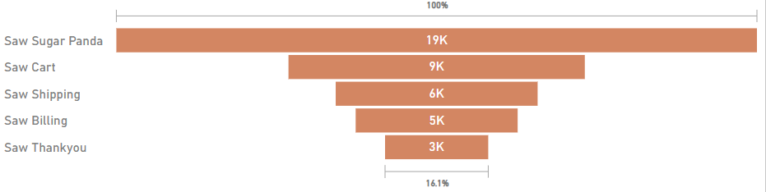
Conversion Funnels:
Sugar Panda: 16.1%

Slide 19
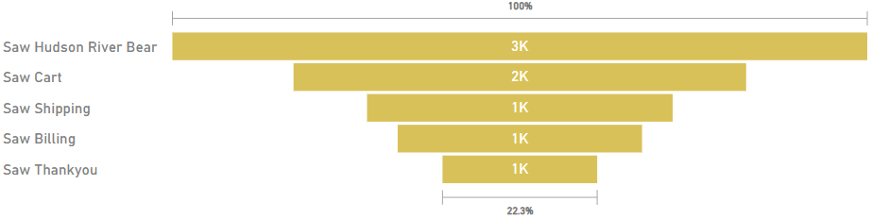
Conversion Funnels:
Hudson River Bear: 22.3%

Slide 20
Conclusion:
The dashboard shows that the website gets a lot of visitors and sales, which is a good sign. However, there are a few areas that need improvement. Some products have high refund rates, many users leave landing pages quickly, and not all users complete the steps in the purchase funnel. By improving product quality and making the shopping process easier and smoother, overall performance can be boosted.

Slide 21
Recommendations:
Focus on improving landing pages with high bounce rates.
Redesign the checkout funnel to reduce cart abandonment.
Investigate refund reasons for "The Original Mr. Fuzzy".
Consider mobile optimization due to notable desktop traffic dominance.
Boost investment in high-performing UTM sources like gsearch and nonbrand.
Run A/B tests on low-performing campaigns and pages.

Slide 22
Thankyou

